Slide 1
Uncontrolled copy not subject to amendment
Airframes
Revision 1.00

Slide 2
Chapter 3:
Manufacturing Technology

Slide 3
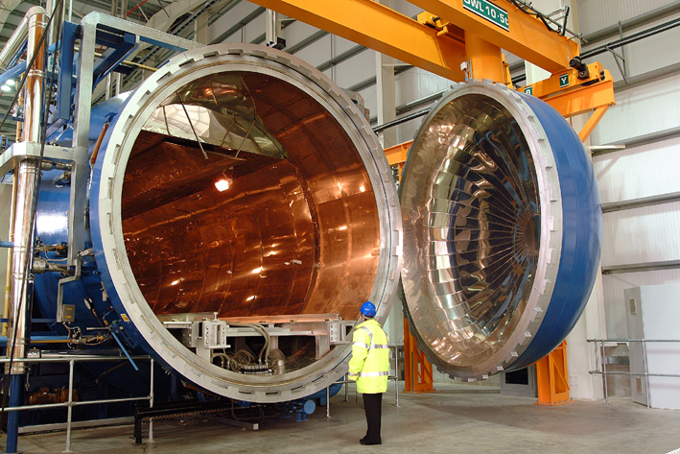

Slide 4
Learning Objectives
The purpose of this chapter is to discuss in more detail, the tools and processes technology that is utilised in the manufacture and assembly of an airframe.
By the end of the lesson you should have an understanding of some of the processes, techniques and tools used in the manufacture of the component parts of an airframe.
But first a recap of Chapter 2 with some questions.

Slide 5
Chapter 2 Revision
A few questions about the previous chapter.
What is meant by the term Homogeneous?
Which of the following 3 materials has the highest Strength to Weight Ratio?
High Tensile Steel
Aluminium
Titanium
Name the one of the three types of Composite Repair?
What does the term GLARE stand for?

Slide 6
What is ‘Man Tech’
Manufacturing technology (or ‘Man Tech’) provides the tooling required to enable the production of all manufactured goods.
These magnify the effort of individual workers and provide the power to turn raw materials into finished and functioning products.
Production tools include machine tools and other related equipment and their accessories and tooling.
Machine tools are non-portable, power-driven manufacturing machinery and systems used to perform specific.
Computer Aided Design (CAD) and Computer Aided Manufacturing (CAM) as well as assembly and test systems to create a subassembly or final product.

Slide 7
Manufacturing Tools & Techniques
For the purposes of this subject, Manufacturing Technology can be broken down into the following sub-sets.
Material removal and tooling
Material forming
Additive processes
Controls/Software
Plastics technology

Slide 8
Material Removal and Tooling
The vast majority of tools and techniques within Manufacturing Technology fall within ‘machining processes’ and perhaps form the basis of the public perception of ‘Manufacturing’.
This can range from the simple hand saw through to laser cutters. The tools and techniques most likely to be used in the manufacture of aircraft structures are;
Turning
Boring
Broaching
Cutting
Electrical Discharge Machining
Milling
Grinding
Drilling

Slide 9
Cutting
Cutting is the most common material removal and machining processes.
Cutting is typically achieved using a cutting blade with hardened teeth to cut through (or ‘Saw’) the workpiece.
Cutting can also be achieved through the use of a high velocity jet of ionised gas that conducts electricity. This technology is referred to as a ‘Plasma Cutter’.
The plasma heats the workpiece, melting material and allows the operator to produce complex cut-outs.

Slide 10
Drilling
Like cutting, drilling is one of the most common material removal and machining processes. It is estimated that over two-thirds of all metal-cutting material removed comes from drilling operations.
Drilling is an operation that uses a hardened rotating tool to produce a round hole in a workpiece. This is accomplished most typically by using a twist drill.
Drilling is generally performed before machining operations such as boring, reaming, tapping, counterboring, countersinking and spotfacing.

Slide 11
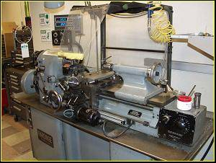
Turning & Boring
Turning is one of the basic machining processes and produces solids of revolution which can be tightly toleranced because of the specialized nature of the operation.
Turning machines can be used to enlarge drilled or cored holes – this process is referred to as ‘Boring’.
The turning process is performed on a machine called a ‘Lathe’ in which the work piece is mounted on the chuck, which rotates relative to the stationary tool.

Slide 12
Grinding
Grinding is a ‘finishing’ process used to improve the surface finish, abrade hard materials, and tighten the tolerance on flat and cylindrical surfaces by removing a small amount of material.
In grinding, an abrasive material rubs against the component to remove material and is typically on the surface of a wheel or belt.
The excessive heat produced during the grinding process, requires the use of fluid within the cutting area to prevent the workpiece becoming damaged or distorted.

Slide 13
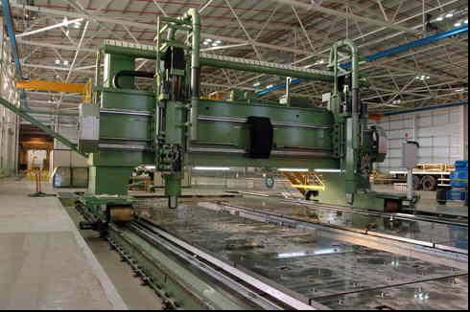
Milling
Milling is as fundamental as drilling among the powered metal cutting processes and uses a rotating cutter that is moved laterally to remove material from the workpiece.
Milling is versatile for a basic machining process, but because the milling set up has so many degrees of freedom, milling is usually less accurate than turning or grinding.
For manual machining, milling is essential to fabricate any object that is not ‘axially symmetric’.

Slide 14
Broaching
Broaching uses a toothed tool, to remove material from the workpiece.
The process is used when precision machining is required, especially for odd shapes as ‘Broaching’ finishes a surface in a single pass, which makes it very efficient.
Commonly machined surfaces include circular and non-circular holes, splines, and flat surfaces. Typical workpieces include small to medium sized castings, forgings, screw machine parts, and stampings.
Even though broaches can be expensive, broaching is usually favorable to other processes when used for high-quantity production runs

Slide 15
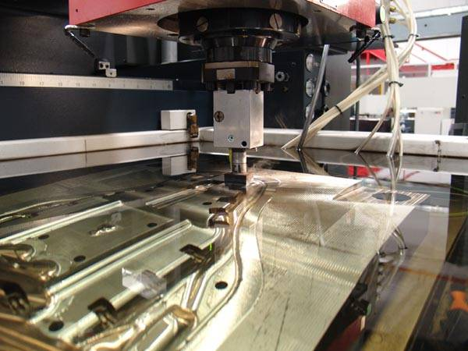
Electrical Discharge Machining
Electrical Discharge Machining (EDM) is also referred to as spark machining, spark eroding, burning, die sinking or wire erosion
The material removal from the workpiece occurs by a series of rapidly recurring current discharges between two electrodes, separated by a dielectric liquid and subject to an electric voltage.
EDM is a manufacturing process whereby the desired shape of the workpiece, is obtained using electrical discharges (or sparks).

Slide 16
Material Forming
Not all components can be manufactured through the use of Material Removal tools & techniques.
It is often advantageous to use Material Forming techniques, where it is easier to manufacture more complex components whilst maintaining the material properties.
Material forming techniques include;
Extrusion
Forging
Bending
Pressing
Casting

Slide 17
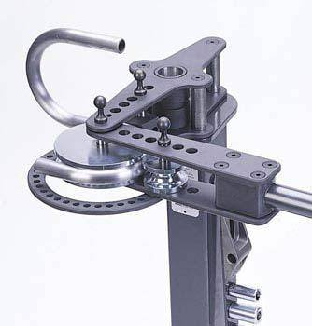
Bending
Another of the basic manufacturing processes, bending is one of the most common material forming processes.
If a bend is required in a workpiece (be it sheet metal, bar or tube), a Bending Machine is used to apply a strain at the desired location to form the designed bend.

Slide 18
Forging
Forging is the term for shaping metal by using localised compressive forces.
Cold forging is done at room temperature or near room temperature, whilst Hot forging is done at a high temperature, which makes metal easier to shape and less likely to fracture.
Warm forging is done at an intermediate temperature between room temperature and hot forging temperatures. Forged parts can range in weight from less than a kilogram to 170 metric tons.
Forged parts usually require further processing to achieve a finished part.

Slide 19
Types of Forging Process
There are many different kinds of forging processes available, however they can be grouped into three main classes:
Drawn out: length increases, cross-section decreases
Upset: Length decreases, cross-section increases
Squeezed in closed compression dies: produces multidirectional flow
Common forging processes include roll forging, swaging, cogging, open-die forging, impression-die forging, press forging, automatic hot forging and upsetting

Slide 20
Casting
Casting is a process by which a liquid material is poured into a mould, which contains a hollow cavity of the desired shape, and then allowed to solidify.
The solidified part is known as a casting, which is ejected or broken out of the mould to complete the process. Casting materials can be metals or various cold setting materials that cure after mixing two or more components together; examples are epoxy, concrete, plaster and clay.
Casting is most often used for making complex shapes that would be otherwise difficult or uneconomical to make by other methods.

Slide 21
Pressing
Pressing is a manufacturing process that allows flat sheets of metal to be formed into three dimensional workpieces
It can also be used to shear the sheet metal in order to cut out forms, press holes or other features using special punches and dies
Pressing machines have a stationary bed and a slide (ram) which uses a controlled reciprocating motion toward and away from the bed surface

Slide 22
Extrusion
Extrusion is a process used to create objects of a fixed cross-sectional profile, where the base material is pushed or drawn through a die of the desired cross-section.
The two main advantages of this process over other manufacturing processes are;
Its ability to create very complex cross-sections and work materials that are brittle, because the material only encounters compressive and shear stresses.
It also forms finished parts with an excellent surface finish.
The extrusion process may be continuous or semi-continuous and can be done with the material hot or cold.

Slide 23
Additive Processes
Additive processes, otherwise known as ‘Rapid Prototyping’ is a manufacturing process for the rapid and flexible production of sample parts for demonstration, evaluation and/or testing.
It typically uses advanced layer manufacturing technologies that can quickly generate complex three dimensional objects direct from computer based models
Rapid prototyping techniques include;
Laminated Object Modelling
Fused Deposition Modelling
Selective Laser Sintering
Stereolithography

Slide 24
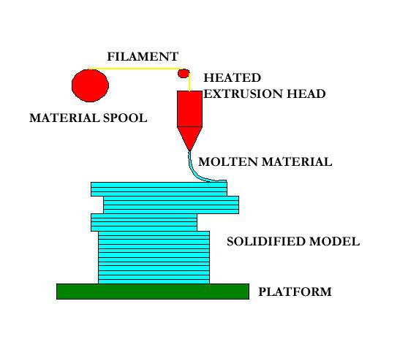
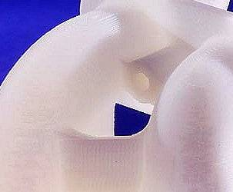
Fused Deposition Modelling
Fused Deposition Modelling is a process which forms three-dimensional objects from CAD-generated solid or surface models.
The Fused Deposition Modelling patterns are generally used when an acroylonitrile-butadiene-styrene thermal plastic part is required for use in a working prototype.

Slide 25
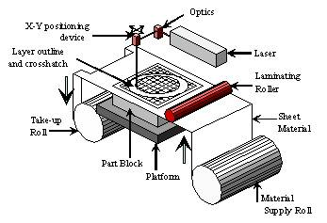
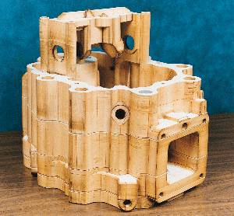
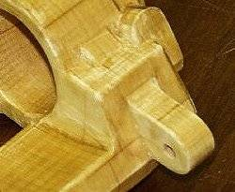
Laminated Object Modelling
Laminated Object Modelling is a process that created models from inexpensive, solid-sheet materials.
The process is similar to that of Sterolithography in that it slices a three-dimensional electronic file from the computer to the Laminated Object Modelling machine to produce parts for use in visualisation models, casting patterns and designs.

Slide 26
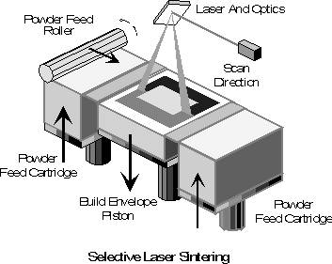
Selective Laser Sintering
Selective Laser Sintering is a flexible technology that uses a CO₂ laser beam to fuse (sinter) layers of nylon, metal or trueform powdered materials into a three-dimensional model.
This is a leading rapid prototyping technology as it provides more choices of materials for flexibility and has more applications than the other technologies.

Slide 27
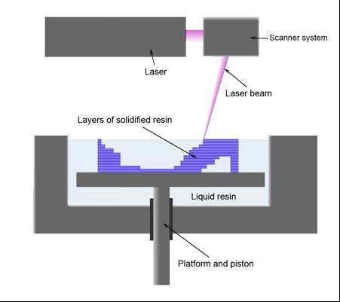
Stereolithography
Stereolithography is a manufacturing technology where the layers are formed using a laser to cure the surface of a bath of photo-sensitive polymer resin in order to produce the desired shape.
The process takes a CAD design and produces a solid three-dimensional prototype model using a combination of laser, photochemistry, optical scanning and computer software technology.

Slide 28
Controls/Software
A feature of modern manufacturing technology, computer software has improved not only the accuracy of the design process, but also the material output.
Often, the more complex machining operations with tight engineering tolerances can only be achieved using tooling controlled by computer.
Typical processes encountered include;

Slide 29
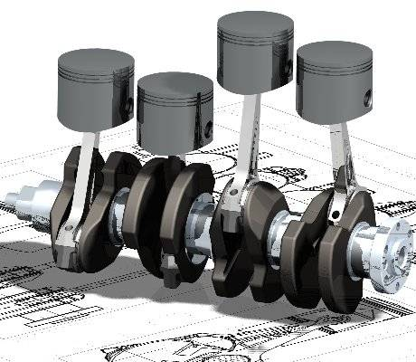
Computer Aided Design
Computer-aided design (CAD) is the use of computer technology for the design of objects, real or virtual.
As in the manual drafting of technical and engineering drawings, the output of CAD must also convey symbolic information such as materials, processes, dimensions, and tolerances.
CAD may be used to design curves and figures in two- dimensional space or curves, surfaces and solids in three- dimensional objects.

Slide 30
Computer Aided Manufacturing
Computer-aided manufacturing (CAM) is the use of software tools in the manufacture of product components.
It’s primary purpose is to create a faster production process and components with more precise dimensions and material consistency, which in some cases, uses only the required amount of raw material (thus minimizing waste), while simultaneously reducing energy consumption.
With CAM it is possible to manufacture physical models using CAD programmes, creating real life versions of components designed within a software package.

Slide 31
Computer Integrated Manufacturing
Computer-Integrated Manufacturing (CIM) is a closed-loop method of manufacturing in which the entire production process is controlled by computer.
The traditional separated process methods are joined through a computer by CIM.
This integration allows the processes to exchange information with each other to initiate actions. Through this, integration the manufacturing can be faster and with fewer errors.
The main advantage is the ability to create automated manufacturing processes.

Slide 32
Numerical Control
Numerical Control refers to the automation of machine tools that are operated by means of predetermined programmed commands, as opposed to manually controlled via handwheels or levers.
This can be found in the following forms;
Computer Numerical Control (CNC): Control of the machine tools is performed by a software programme executed by a computer.
Direct Numerical Control: Control of a number of CNC machines by a large centralised host computer.
Distributed Numerical Control: Hierarchical control of all machine tools controlled by a central plant computer, where the controllers are themselves CNC units.

Slide 33
Plastics Technology
Plastics technology is the collective of processes used to turn a wide range of synthetic or semi-synthetic organic amorphous solid materials into a final product.
A number of processes are available, but for the purposes of this chapter the following will be considered further;
Die
Co-Injection Moulding
Extrusion
Blow Moulding
Compression Moulding
Injection Moulding
Thermoforming
Curing

Slide 34
Blow Moulding
Blow Moulding is a manufacturing process by which hollow plastic parts are formed from thermoplastic materials.
There are three main types of blow moulding;
Extrusion Blow Moulding: produces a hollow plastic tube from the die head and then expanded within the cavity by air pressure to produce a blown object.
Injection Blow Moulding: supported by a metal core pin to produce blown objects.
Stretch Blow Moulding: is used in both of the above types to produce odd blown shapes, referred to as Bi-oriented.

Slide 35
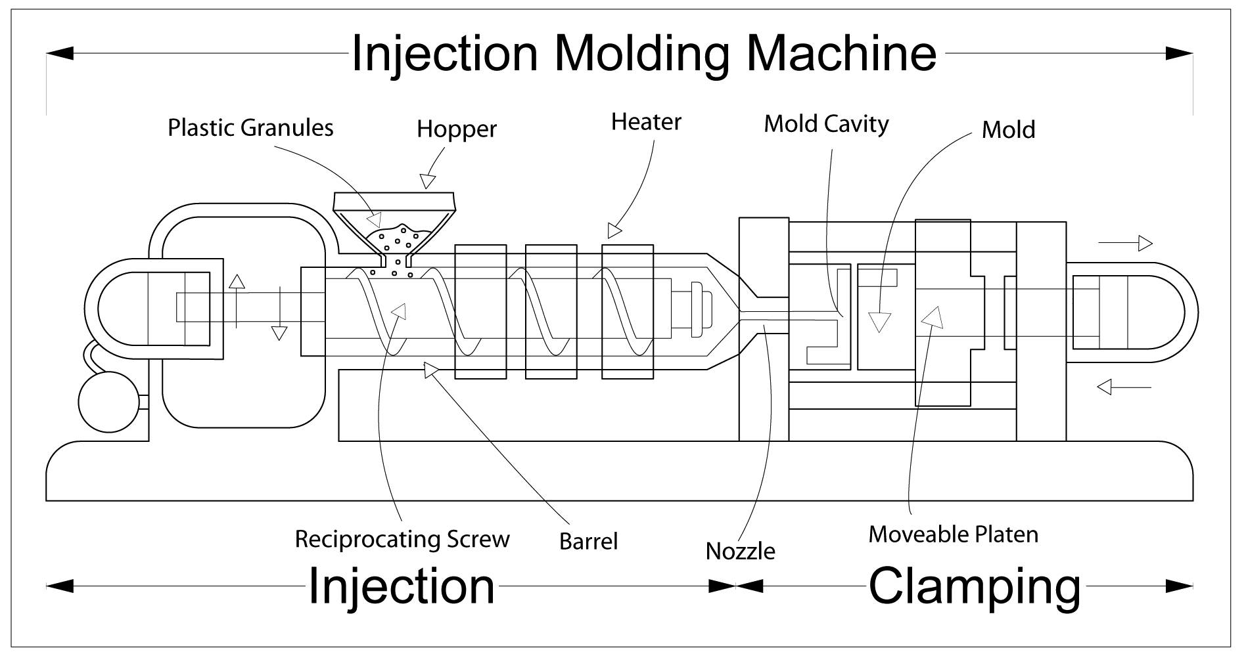
Injection Moulding
Injection Moulding is a manufacturing process for producing parts from both thermoplastic and thermosetting plastic materials.
Material is fed into a heated barrel, mixed, and forced into a mould cavity where it cools and hardens to the configuration of the mould cavity.

Slide 36
Co-Injection Moulding
The Co-Injection Moulding process is similar to that of the Injection Moulding process.
The key difference is that the mould cavity is first partially filled with one plastic and then a second shot is injected to enclose the first shot.
There a two types, Machine Based and Mould Based.

Slide 37
Compression Molding
Compression moulding uses material, generally preheated, that is first placed in an open, heated mould cavity. The mould is closed with a and pressure is applied to force the material into contact with all mould areas. Heat and pressure are maintained until the moulding material has cured.
The process employs thermosetting resins in a partially cured stage and advanced composite thermoplastics can also be compression moulded with unidirectional support material.
The advantage of compression moulding is it’s ability to mould intricate parts and produces fewer knit lines and less fibre-length degradation than injection moulding.

Slide 38
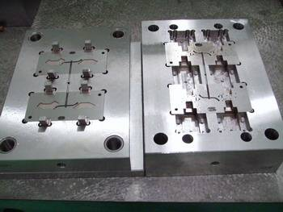
Die
Within the context of Plastics Technology, the term die, mould and tool are sometimes considered the same.
This is considered true in that they have a female or negative cabity through, or into, which the molten plastic moves under heat and pressure.

Slide 39
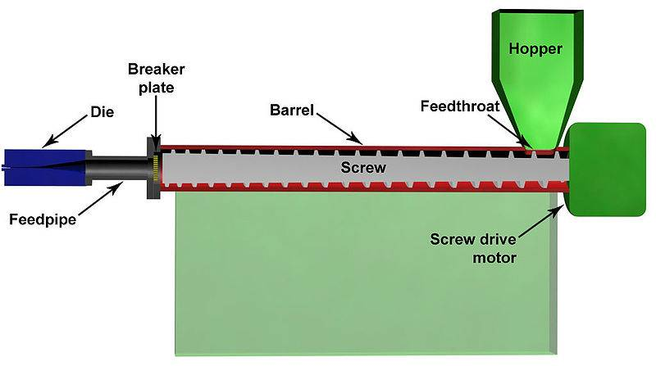
Plastics Extrusion
Plastics extrusion is a high volume manufacturing process in which raw plastic material (often in bead form) is melted and forced through a die to form a single continuous profile.
The process is similar to that of Metal Extrustion.

Slide 40
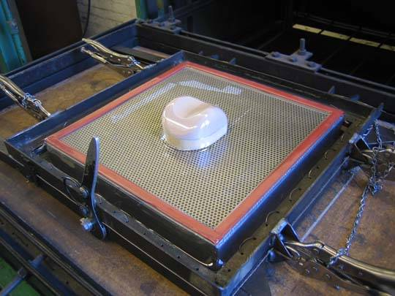
Thermoforming
Thermoforming is a manufacturing process where a plastic sheet is heated to a pliable forming temperature, formed to a specific shape in a mould, and trimmed to create a usable product.
The plastic sheet is heated to a high-enough temperature, so that it can be stretched into or onto a mould using a vacuum and cooled to a finished shape.

Slide 41
Curing
Curing is the process that refers to the toughening or hardening of a polymer material by cross-linking of polymer chains, brought about by the use of chemical additives, ultraviolet radiation, electron beam or heat.
In rubber, the curing process is also called vulcanization.
With composite materials, the final process involves curing the assembly using heat in an ‘Auto-clave’ or large oven.

Slide 42
Ultimate Aim!
By using the previously mentioned tools, techniques and processes, it is possible to do the following…..

Slide 43
Conclusions
Manufacturing Technology covers a wide variety of tools, techniques and processes – all utilised to transform raw materials into finished products.
Although not all tools, techniques and processes applicable to airframe manufacturing have been covered within this chapter, you should now be familiar with the basics of manufacturing technology.
Any Questions ?

Slide 44
Questions
Here are some questions for you!
What is meant by ‘Forging’?
What does the acronym CNC stand for?
What is an ‘Additive Process’?
Name the 5 Manufacturing Technology sub-groupings?

